Slide 1

PREDICTING THE PRICES OF AIRBNB IN NEW YORK CITY
Author - Tran Tuan Vu

Slide 2
Overview
If for some reason you don’t already know, Airbnb is a internet marketplace for short-term home and apartment rentals.
Problem: Airbnb pricing is important to get right, particularly in big cities like London, New York, Tokyo,…. where there are lots of competition and even small differences in prices can make a big difference. It is also a difficult thing to do correctly — price too high and no one will book
Interest: traveler, business man, student, supplier,…

Slide 3
Data acquisition and cleaning
The dataset used for this project comes from Kaggle (https://www.kaggle.com/dgomonov/new-york-city-airbnb-open-data).
This dataset has around 49,000 observations in it with 16 columns and it is a mix between categorical and numeric values.
Data downloaded from public dataset of Airbnb. The data is quite messy, and has some limitations.
Each row in the data set is a listing available for rental in Airbnb’s site for the specific city (observations). The columns describe different characteristics of each listing (features).
There was 4 features which had missing values. It includes : “name, host_name, last_review, review_per_month”.
For “review_per_month” column, we can simply append it with 0.0 for missing values; we can see that in “number_of_review” that column will have a 0, therefore following this logic with 0 total reviews there will be 0.0 rate of reviews per month.
For “name, host_name” column, we can drop it out dataset because these is insignificant and ethical reason.
Feature selection: the features were kept include: 'neighbourhood_group', 'latitude', 'longitude', 'room_type', 'price', 'minimum_nights', 'number_of_reviews', 'reviews_per_month', 'calculated_host_listings_count', 'availability_365'.

Slide 4
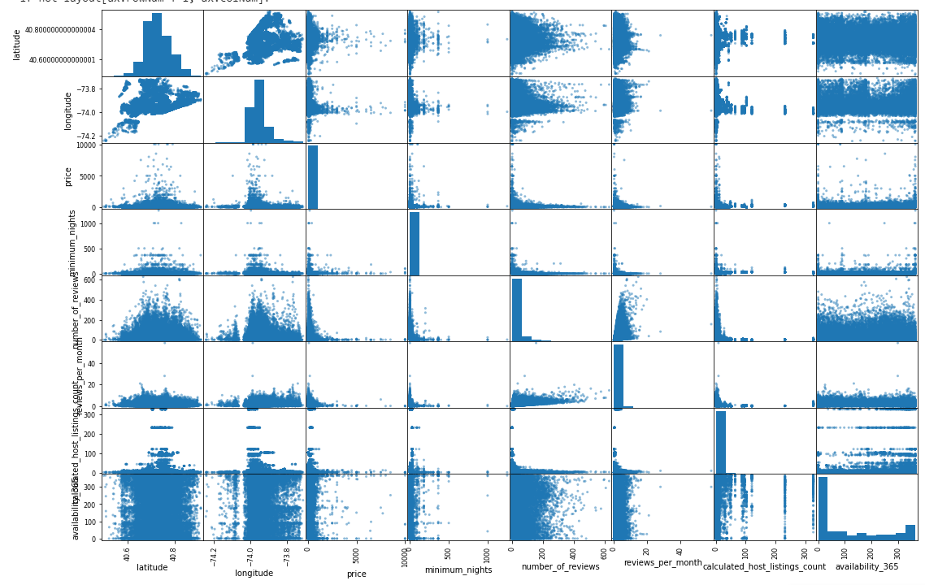
EDA – Exploratory Data Analysis
1. Scatter Matrix with continuous variabales

Slide 5
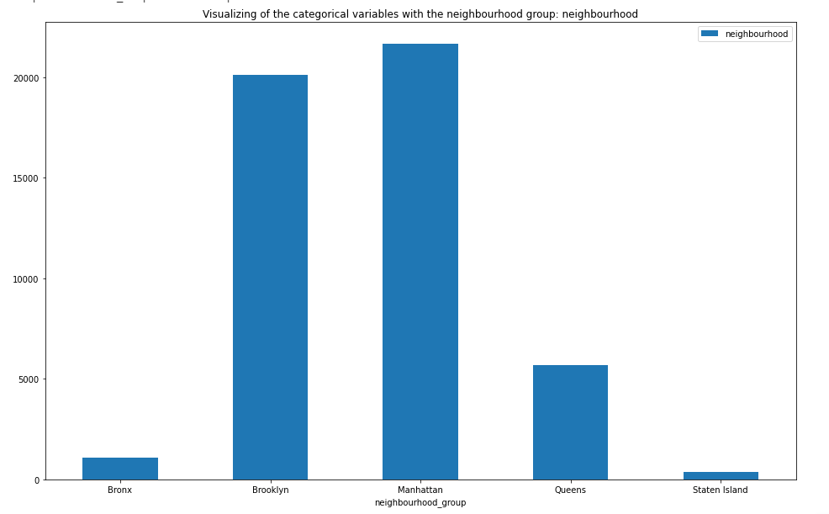
EDA – Exploratory Data Analysis
2. Visualization total price with categorical variables
2.1. Price and Neighbourhood group

Slide 6
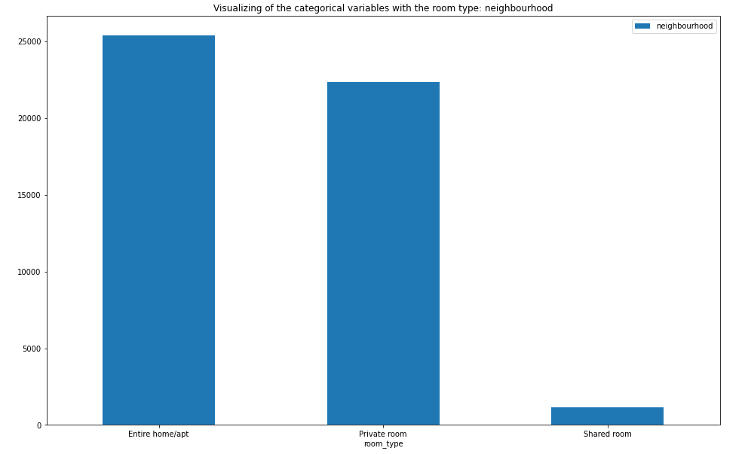
EDA – Exploratory Data Analysis
2.2 Price and Room type

Slide 7
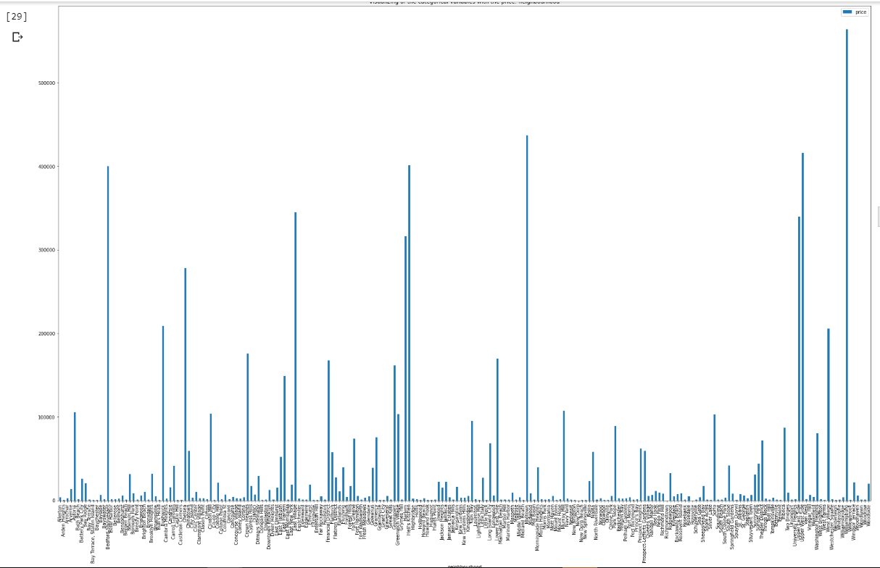
EDA – Exploratory Data Analysis
2.3. Price and neighbourhood

Slide 8
EDA – Exploratory Data Analysis
3. Plotting Neighbourhood group with Neighbourhood

Slide 9
EDA – Exploratory Data Analysis
4. Plotting Room Type with Neighbourhood

Slide 10
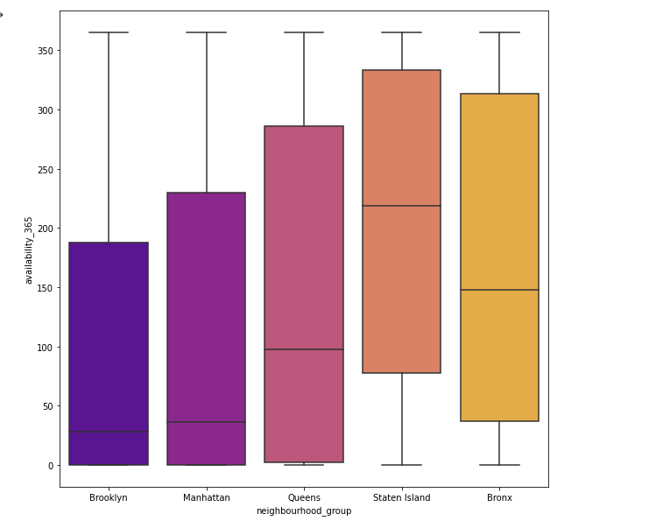
EDA – Exploratory Data Analysis
5. Visualizing bar plot between neighbourhood_group and availablity of room

Slide 11
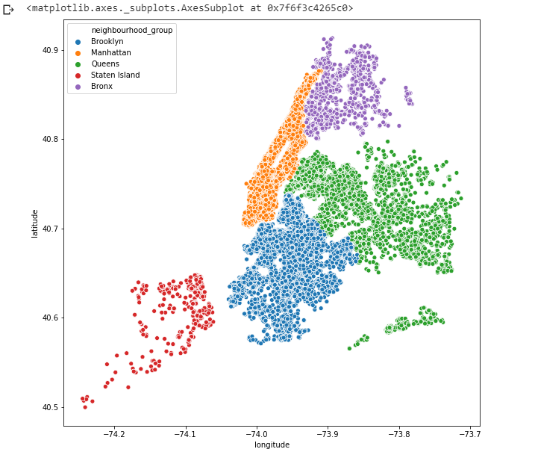
EDA – Exploratory Data Analysis
6. Map of Neighbourhood Group

Slide 12
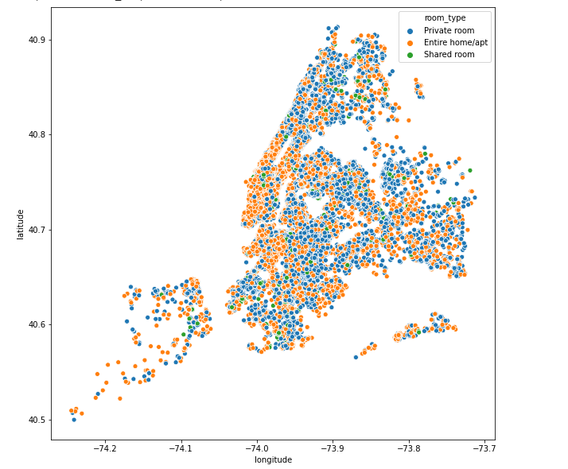
EDA – Exploratory Data Analysis
7. Map of Neighbourhood

Slide 13
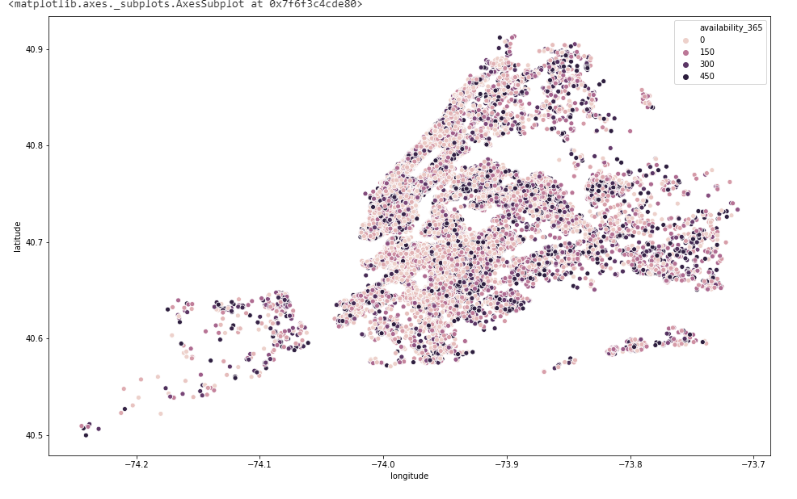
EDA – Exploratory Data Analysis
8. Availability of Room

Slide 14
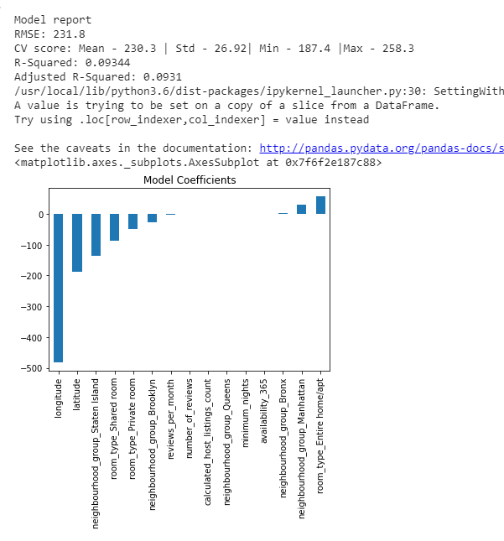
PREDICTIVE MODELING
1. Linear Regression

Slide 15
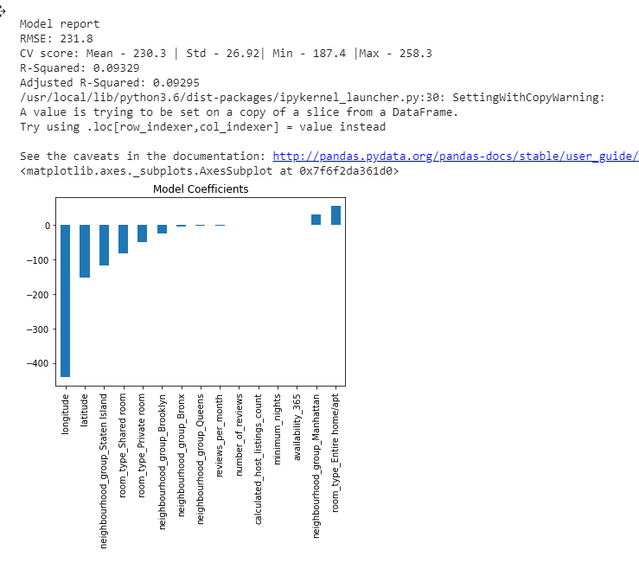
PREDICTIVE MODELING
2. Ridge Regression

Slide 16
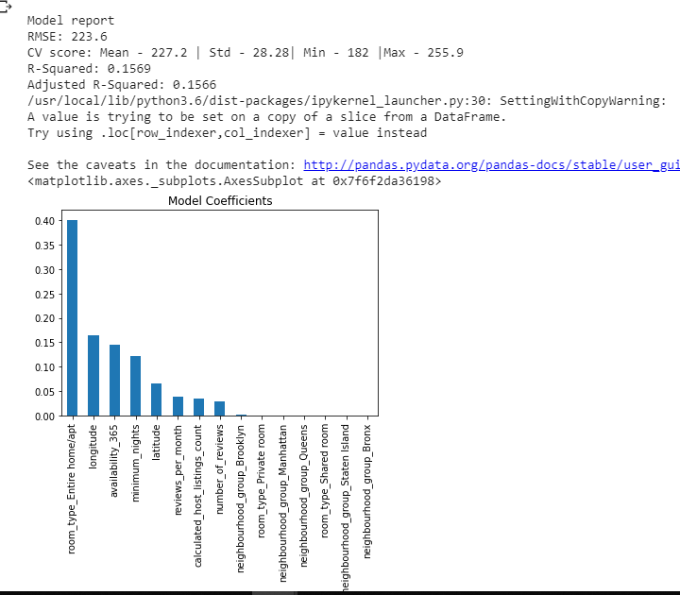
PREDICTIVE MODELING
3. Decision Tree

Slide 17
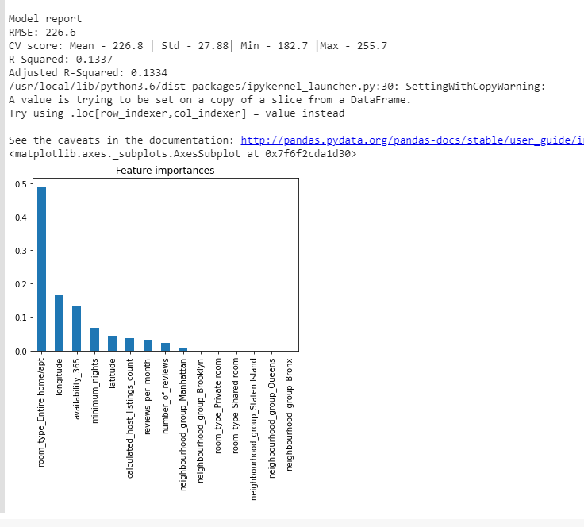
PREDICTIVE MODELING
4. Random Forest

Slide 18
PREDICTIVE MODELING
5. Performances of different models
 | Linear Regression | Rigde regression | Decision tree | Random forest
Weighted RMSE | 231.8 | 231.8 | 223.6 | 226.6

Slide 19
CONCLUSION
This Airbnb ('AB_NYC_2019') dataset for the 2019 year appeared to be a very rich dataset with a variety of columns that allowed us to do deep data exploration on each significant column presented
This is one of those situations where machine learning simply is necessary for prediction, and a machine learning model performs just as well.
This is one of those situations where machine learning simply is necessary for prediction, and a machine learning model performs just as well.

Slide 20
THANK YOU

